Slide 1
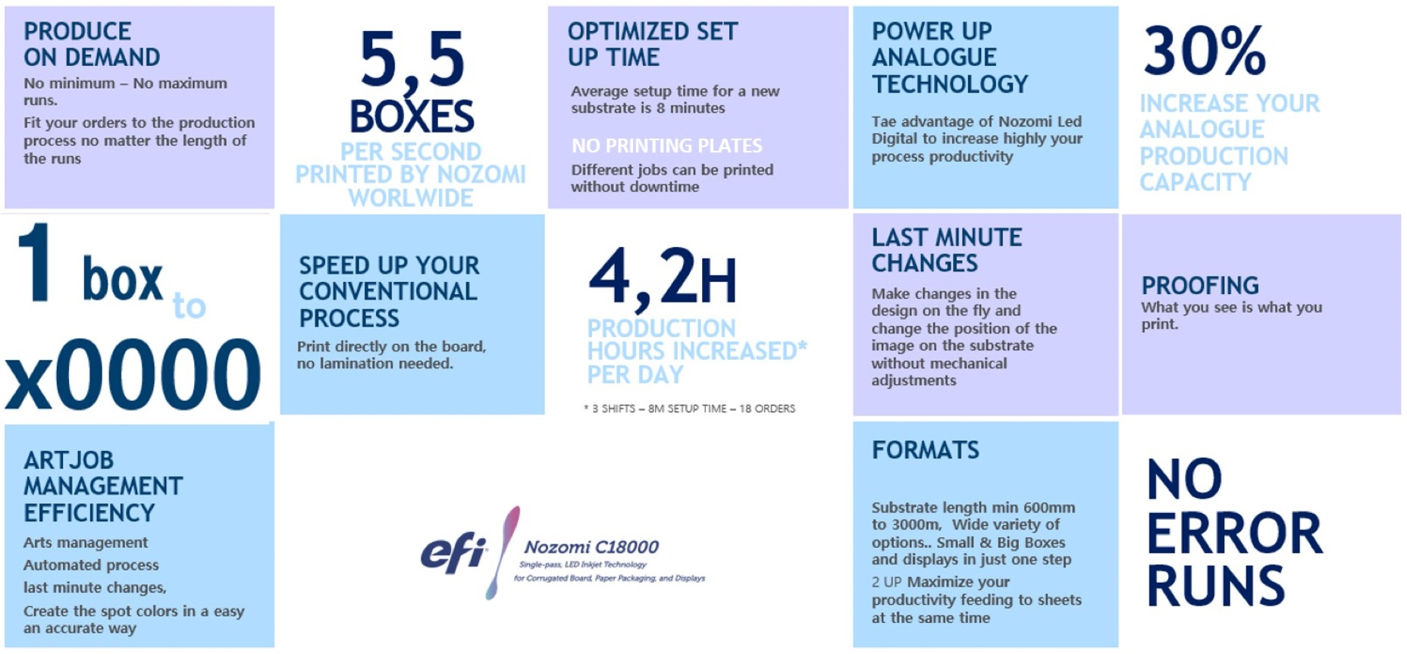

Slide 3

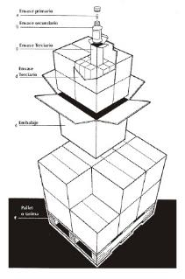
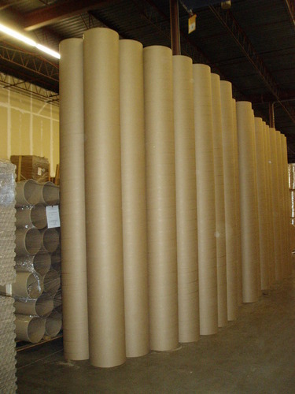


4. MARKET TRENDS
KEY IMPLICATIONS
Plus
globalisation
PRIMARY PACKAGING
Key implications
SECONDARY PACKAGING
NOZOMI INKS ARE SUITABLE FOR USE SAFETY FOOD IN SECONDARY PACKAGING APPLICATIONS
REDUCE WASTE
Nozomi´s LED Digital process is highly efficient in all areas of the production process
    No Print Tools
    Printing on demand minimizes waste and cost associated to overrun or inventory obsolescence
    Inks
    No need of Chemicals or water for pre-press
    Digital Inventories saves warehouse and transport impacts
    Substrate optimization
FOOD PACKAGING
Nozomi Inks are suitable for use in food safety packaging applications, where the ink is printed on the outside of food packaging, and the packaging itself act as a functional barrier.
Nozomi understanding of digital packaging industry, and dedicated resources, help support customers and brands.
SUSTAINABITY IMPACT
Nozomi´s LED Digital process is highly efficient in all areas of the production process
Nozomi inks are recyclable
Low VOC Greenguard certified
                EFI LED inks contain no hazardous volatile organic compounds and do not require vapor recovery
Low odor
Most Energy Consumption
EFI Nozomi C18000 Most Energy Efficient Based on ISO 20690 Energy Standard

Slide 4
5. TCO
Direct cost
Plus
HOW TO MONETIZE
Fast time-to-market
Easy Check Control
Just in Time Manufacturing
COST OF DIGITAL
VS THE VALUE OF DIGITAL
Warehouse optimisation
Zero, Reduced or Exact inventory
No error Runs
Lower Total System Cost
No plates cost
Streamline Process
Reduce Material Waste
Versionning & Personalization
Unit Cost
Environmental Care increased
Extra invertory, just in Case
Market Share Growth
Conventional Package
Decoration
Digital Package
Decoration

Slide 5




7. WHY NOZOMI
DIGITAL IMPROVEMENT
Plus
Digital improvement depending on rolls
WHY IS NOZOMI SO ATTRACTIVE TO BRANDS & RETAILERS
REDUCE COST
NO RISK
ENVIROMENT
INCREASE SALES
Global Color Management
Optimise paper consumption
Reduce WIP and finished goods inventory
Optimize your production process
Align production volume to demand
Market Tested
Reduce obsolescence
Quality Control
Efficient, cost-effective version testing
Reduce Time to Market
Consistent color management
Last minute content changes
Increased speed to market
Volume based on demand
Print Quality
Just-in-time production
Track & Trace
Lowest energy consumption certification
Reduce production waste
Reduce obsolescence
No ink VOC's
Ink is certified recyclable
Only print when is needded
Cost-effective versioning
Localized content
Cause-driven promotions
Event promotions
Late stage product differentiation
Product Life Cycle solutions
Reduce Time To Market
Mass Customization
React to Market Demand

